Slide 1
Asymptotically Unbiased Estimation for Delayed Feedback Modeling via Label Correction
Yu Chen, Jiaqi Jin, Hui Zhao, Pengjie Wang, Guojun Liu, Jian Xu and Bo Zheng
WWW 2022

Slide 2
Contents
Background
Importance Sampling
Approach
Experiments

Slide 3
Contents
Background
Importance Sampling
Approach
Experiments

Slide 4
Background
Setting: online CTR / CVR prediction
Problem: trade-off between model freshness and label correctness
Model freshness: train on fresh feedbacks
Label correctness: waiting for accurate labels

Slide 5
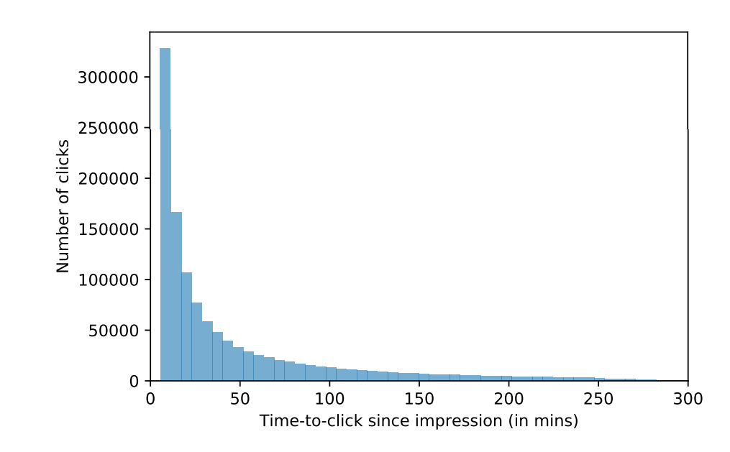
Background
CTR time distribution (exponential)

Slide 6
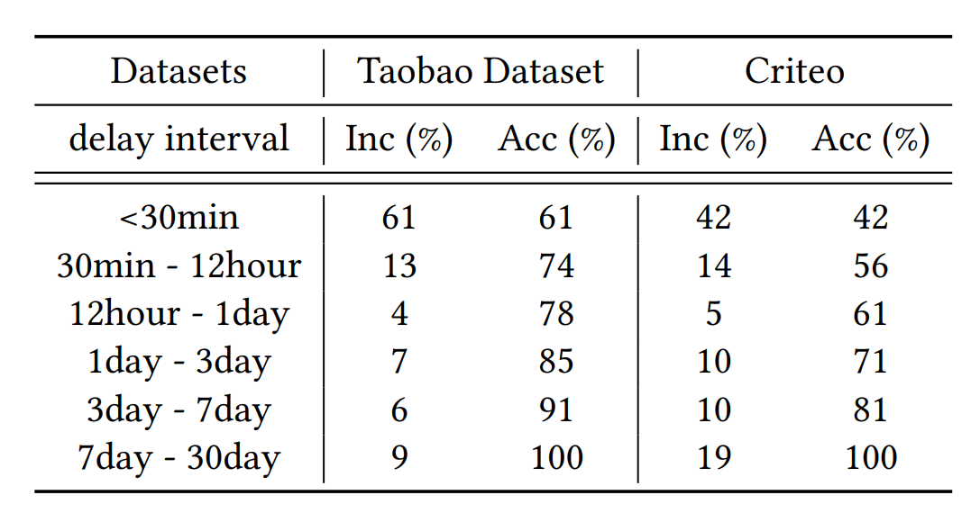
Background
CVR time distribution

Slide 7
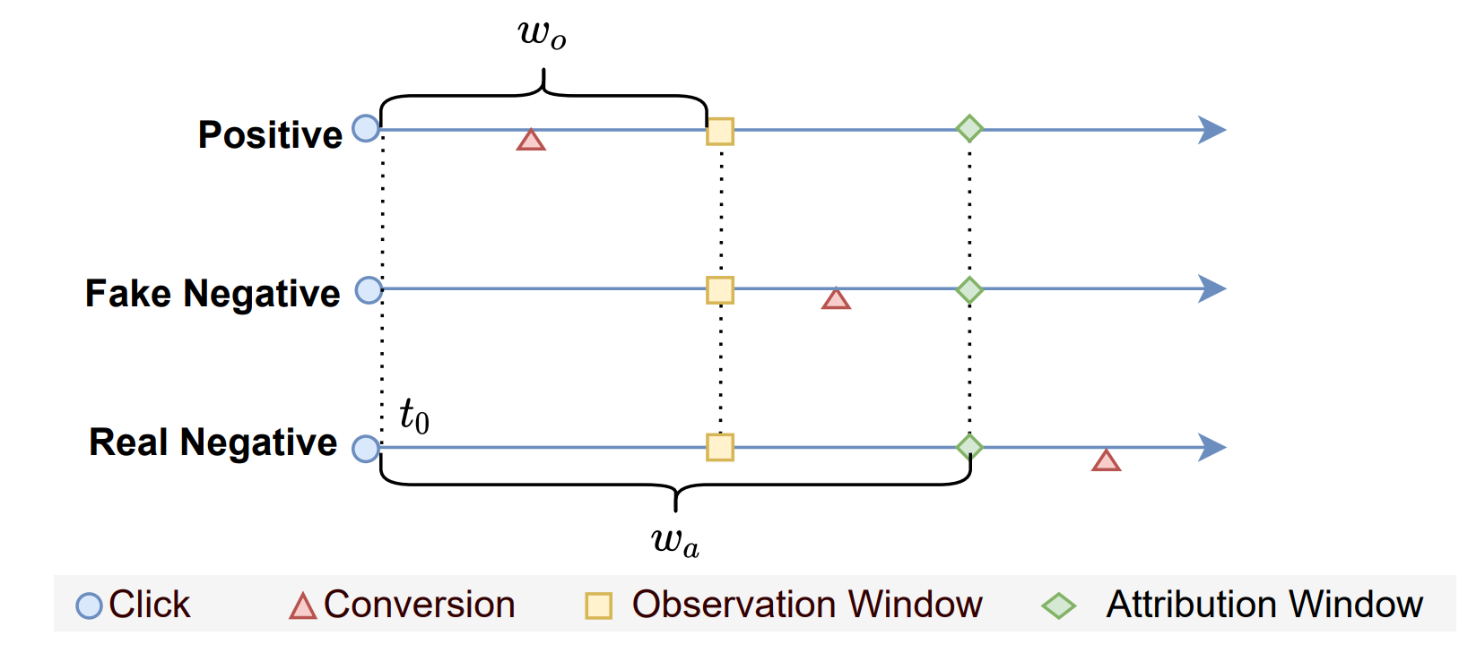
Background

Slide 8
Approaches
Approach 1: Learn the time distribution function
Approach 2: Multi-task model -> different time level
Approach 3: Duplicate positive + Importance sampling

Slide 9
Approaches
Approach 1: Learn the time distribution function
Approach 2: Multi-task model -> different time level
Approach 3: Duplicate positive + Importance sampling

Slide 10
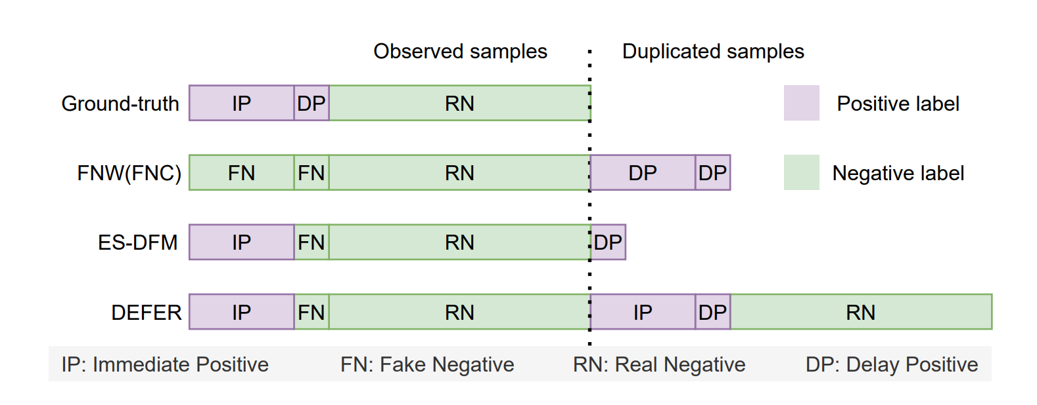
Background
Dataset: IP, FN, RN and DP

Slide 11
Contents
Background
Importance Sampling
Approach
Experiments

Slide 12
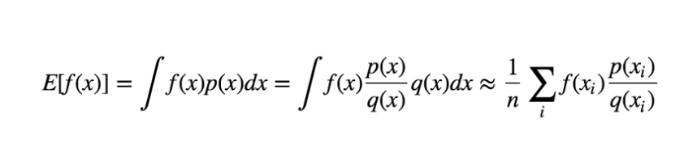
Importance Sampling
Two distributions: p(x) and q(x)
Get: E(x)~p(x) with q(x)

Slide 13
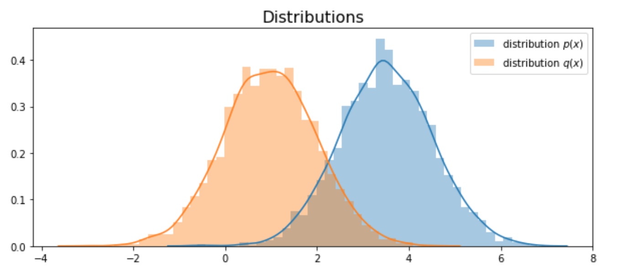
Importance Sampling
Two distributions: p(x) and q(x)

Slide 14
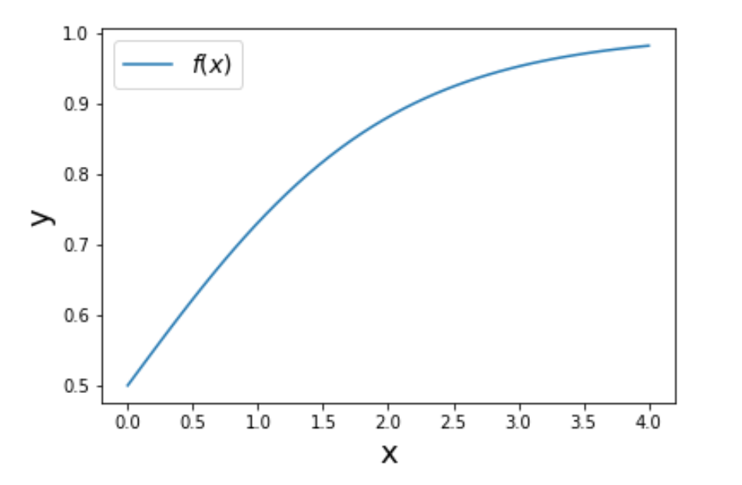
Importance Sampling
Get E[f(x)] by importance sampling

Slide 15
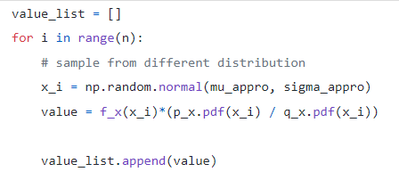
Importance Sampling
Get E[f(x)]~p(x) by importance sampling
Pdf: probability distribution function

Slide 16
Contents
Background
Importance Sampling
Approach
Experiments

Slide 17
Previous methods
Step 1: Duplicate positive samples
Step 2: Importance sampling

Slide 18
Previous methods
Step 1: Duplicate positive samples
Step 2: Importance sampling

Slide 19
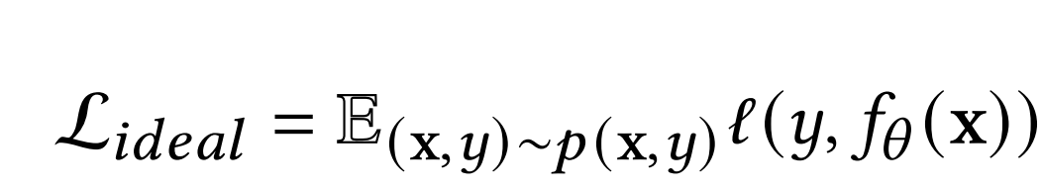
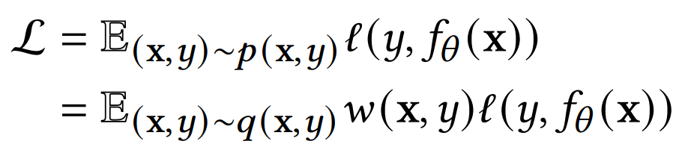
Fake negative weighted
Ideal loss function:
Rewrite loss function with importance sampling:

Slide 20

Fake negative weighted
Ground-truth distribution: p(x)
Observed distribution: q(x)
Then we get:
q(x|y = 0) = p(x) q(y = 1|x) = p(y = 1|x) / (1 + p(y = 1|x))
q(x|y = 1) = p(x|y = 1) => q(y = 0|x) = 1 / (1 + p(y = 1|x))
q(y = 0) = 1/(1 + p(y = 1))

Slide 21
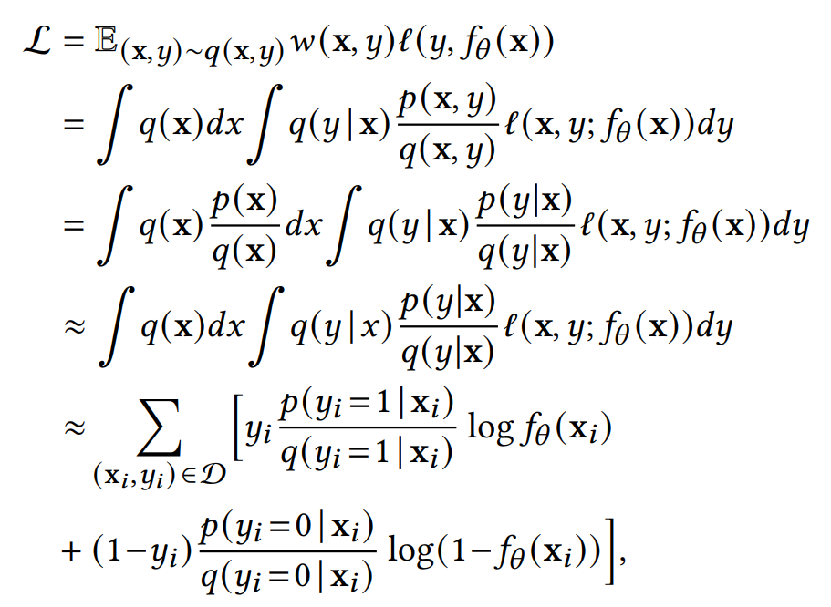
Fake negative weighted
Importance sampling:

Slide 22
Fake negative weighted
Importance sampling: p(x) ≈ q(x)

Slide 23
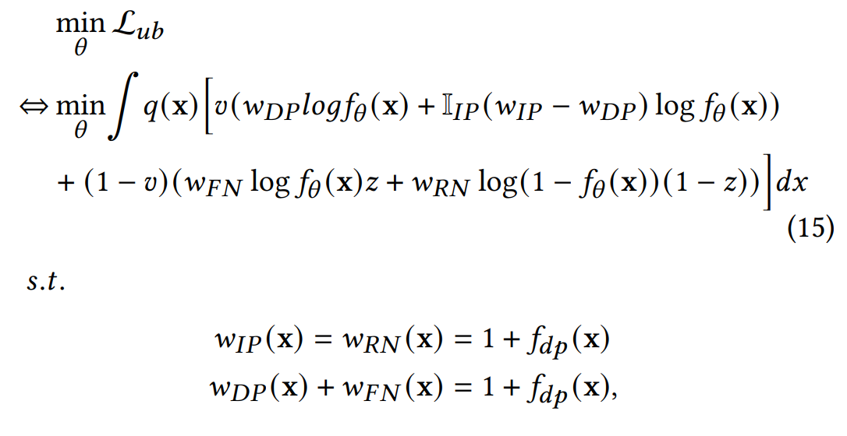
Asymptotically Unbiased Estimation
Unbiased loss:
Notes:
z(x): fake negative probability

Slide 24
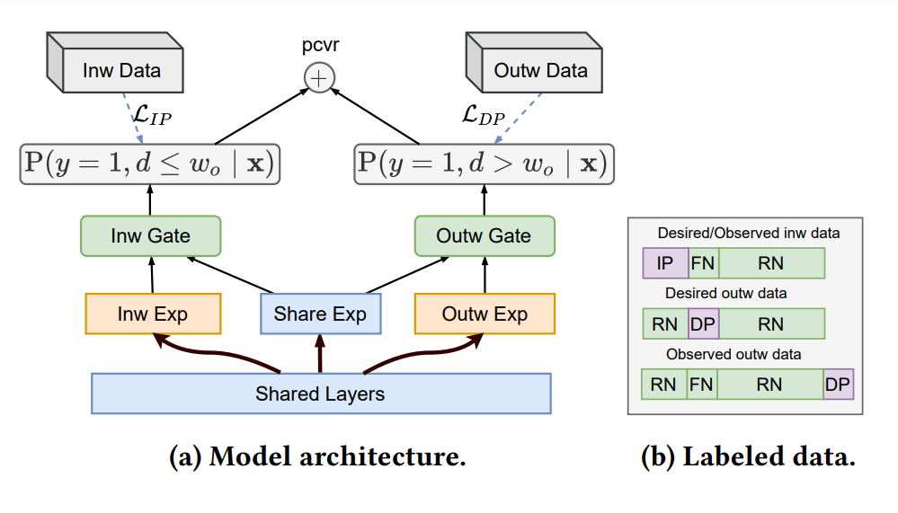
Bi-Distribution Modeling

Slide 25
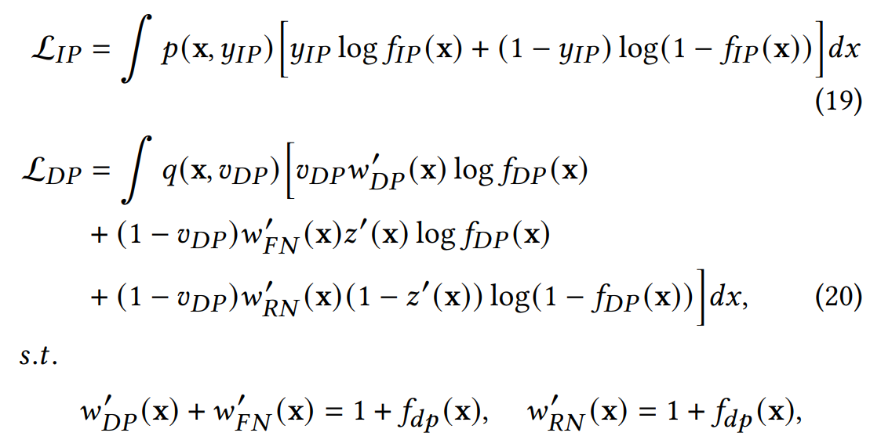
Bi-Distribution Modeling

Slide 26
Contents
Background
Importance Sampling
Approach
Experiments

Slide 27
Baselines:
Pre-trained: trained by the first part of data alone
Oracle: finetuned with the ground-truth label
Vanilla: without any duplicate samples (CE loss function)
Vanilla-Win: with any duplicated samples (CE loss function)
Previous works: FNW, FNC, ES-DFM and DEFER
Evaluation Metrics: AUC

Slide 28
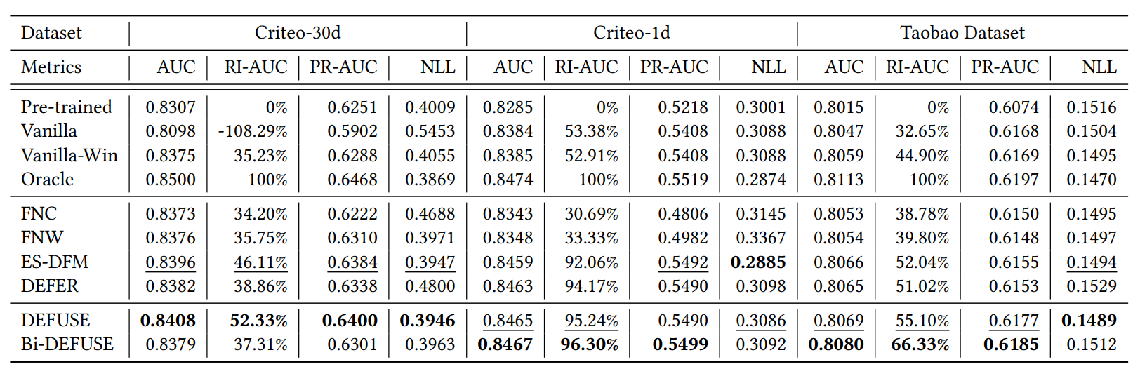
Performance Comparison

Slide 29
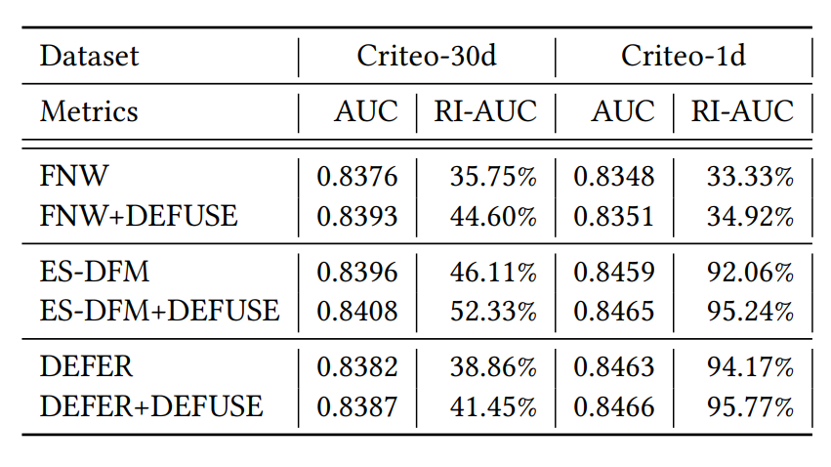
Different Duplicating Mechanisms

Slide 30
Conclusion
Pros:
Asymptotically unbiased
Orthogonal to previous works
Cons:
Need estimation of fake negative probability z(x)

Slide 31
Q&A

